Slide 1
Tableau Module 11
Data Analytics

Slide 2


























Common Charts
Data Views
Hierarchies
Data Structures
Basic Navigation
Dashboards
Data Stories
Calculations
Advanced
Charts
Certification Springs
Blending
Done
You are here

Slide 3
Learning Outcomes
Understand bins in Tableau
Demonstrate creating logical functions
Understand Key Performance Indicators
Demonstrate Annotations

Slide 4
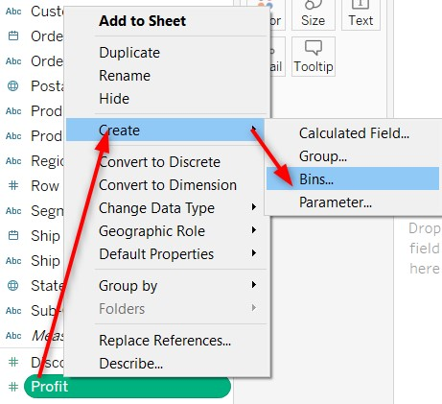
Bins and Histograms

Slide 5
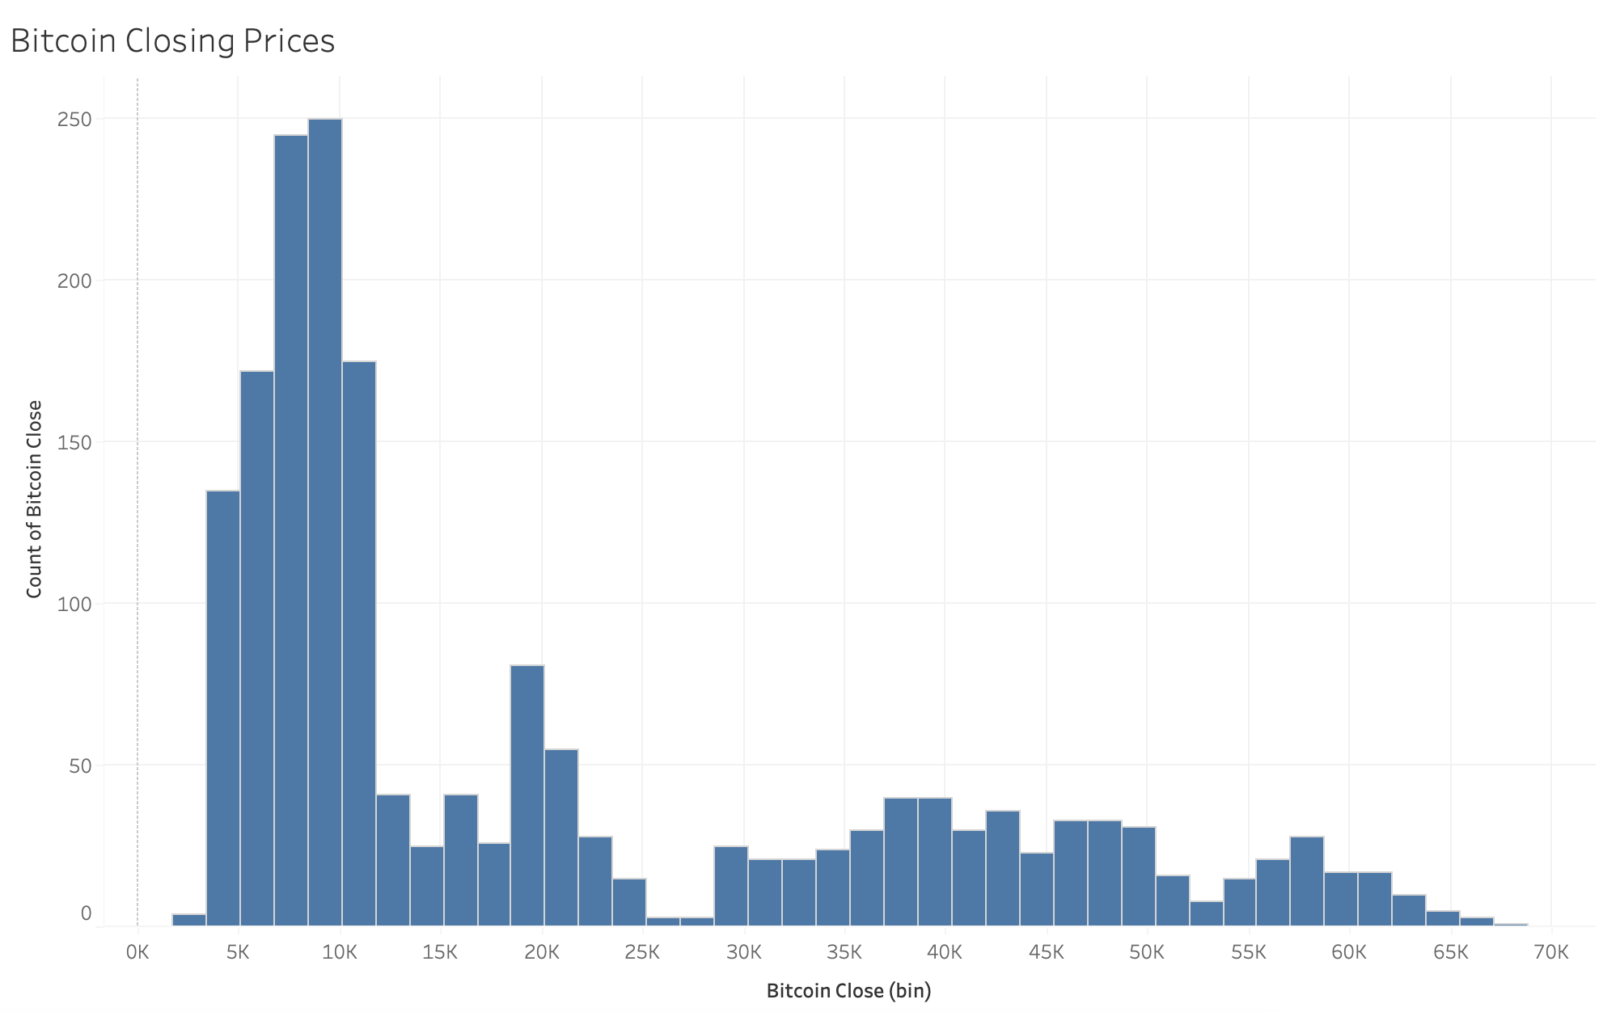
Bins and Histograms

Slide 6
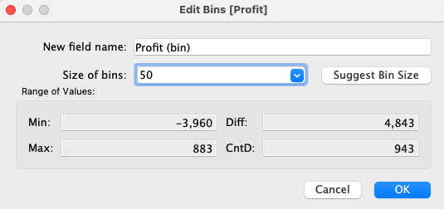
Bin Size

Slide 7
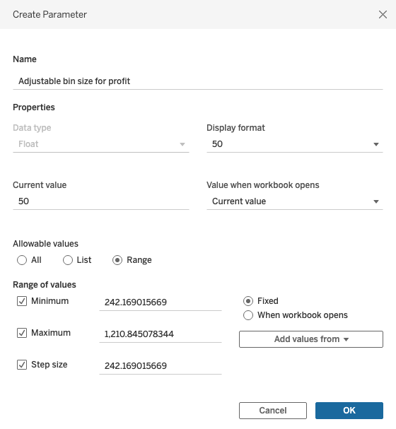

Bin Size Parameter

Slide 8
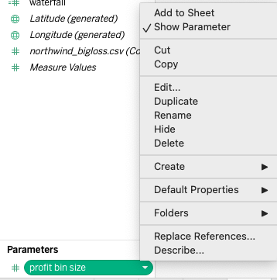

Show Bin Size Parameter

Slide 9
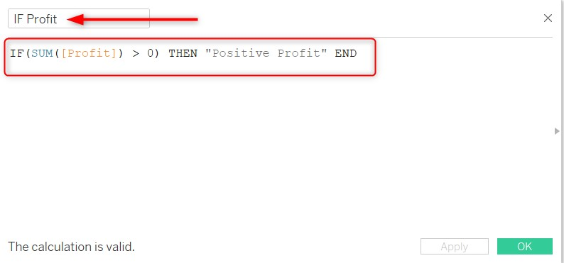
Logical Functions
AND - used to compare multiple values. For example, Expression_1 AND Expression_2.
NOT - used to check if one value is not equal to another. For example, NOT(Expression).
OR - used to test multiple conditions at the same time. For example, Expression_1 OR Expression_2.
IF ELSE (IIF) - If the condition is True, it will return the first statement; otherwise, the second statement. For example, IIF(Expression, True_statement, False_Statement).
ISNULL - used to check for null values. For example, ISNULL(Expression).
IFNULL - used to replace null values. For example, IFNULL(Expression, Value).

Slide 10
Logical Functions in Depth
https://help.tableau.com/current/pro/desktop/en-us/functions_functions_logical.htm
IN | <expr1> IN <expr2>
AND | IF <expr1> AND <expr2> THEN <then> END
CASE | CASE <expression> WHEN <value1> THEN <return1> WHEN <value2> THEN <return2> ... ELSE <default return> END
ELSE | IF <expr> THEN <then> ELSE <else> END
ELSEIF | IF <expr> THEN <then> [ELSEIF <expr2> THEN <then2>...] [ELSE <else>] END
END | IF <expr> THEN <then> [ELSEIF <expr2> THEN <then2>...] [ELSE <else>] END
IF | IF <expr> THEN <then> [ELSEIF <expr2> THEN <then2>...] [ELSE <else>] END
IFNULL | IFNULL(expr1, expr2)
IIF | IIF(test, then, else, [unknown])
ISDATE | ISDATE(string)
ISNULL | ISNULL(expression)
MAX | MAX(expression) or Max(expr1, expr2)
MIN | MIN(expression) or MIN(expr1, expr2)
NOT | IF NOT <expr> THEN <then> END
OR | IF <expr1> OR <expr2> THEN <then> END
THEN | IF <expre> THEN <then> [ELSEIF ,expr2> THEN <then2>...] [ELSE <else>] END
WHEN | CASE <expr> WHEN <Value1> THEN <return1> ... [ELSE <else>] END
ZN | ZN(expression)

Slide 11
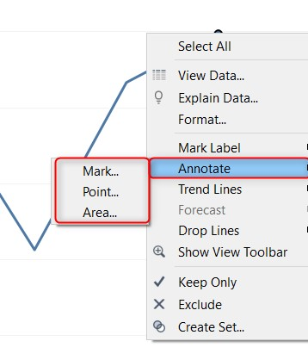
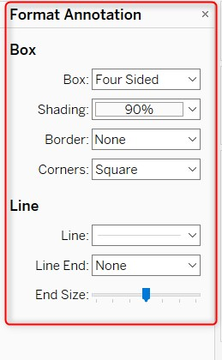
Annotations

Slide 12
Key Performance Indicators (KPIs)
Key Performance Indicators (KPIs) are the quantifiable indicators of progress toward an intended result.
KPIs provide a focus for strategic and operational improvement, create an analytical basis for decision making and help focus attention on what matters most.
All KPIs are metrics but not all metrics are KPIs

Slide 13
KPI Types
Inputs measure attributes (amount, type, quality) of resources consumed in processes that produce outputs
Process or activity measures focus on how the efficiency, quality, or consistency of specific processes used to produce a specific output; they can also measure controls on that process, such as the tools/equipment used or process training
Outputs are result measures that indicate how much work is done and define what is produced
Outcomes focus on accomplishments or impacts, and are classified as Intermediate Outcomes, such as customer brand awareness (a direct result of, say, marketing or communications outputs), or End Outcomes, such as customer retention or sales (that are driven by the increased brand awareness)
Project measures answer questions about the status of deliverables and milestone progress related to important projects or initiatives

Slide 14

All Work Is a Process
Inputs
Process
Outputs
Outcomes
Project

Slide 15
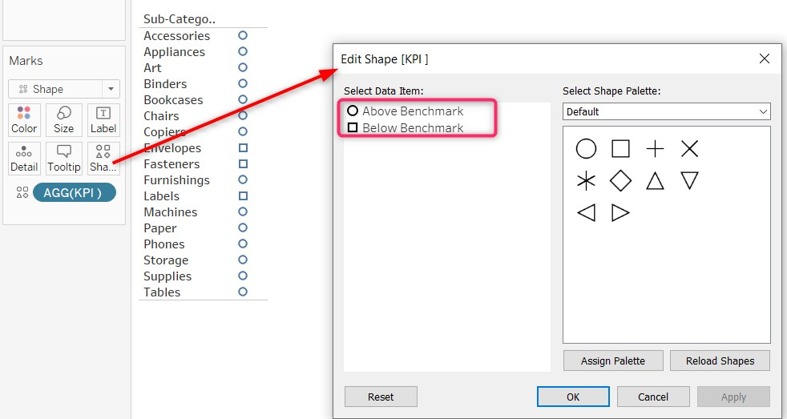
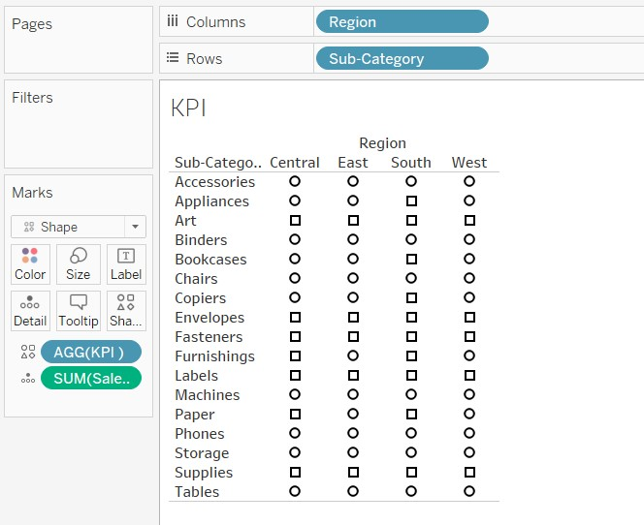
Key Performance Indicators

Slide 16
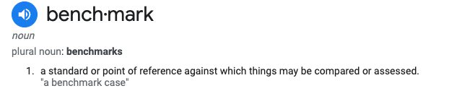
Benchmarks
internal benchmarks: what we think the measure value should be
external benchmarks: what the rest of the world thinks the measure value should be

Slide 17
Profit Benchmarks
Industry | Gross Profit Margin
Advertising | 23.99%
Apparel | 49.77%
Auto and Truck | 9.04%
Banks (Regional) | 99.75%
Building Materials | 28.38%
Computer Services | 27.16%
Home Furnishings | 27.03%
Healthcare Products | 56.94%
Recreation | 37.58%
Restaurants and Dining | 27.60%
Retail (General) | 24.27%
Retail (Online) | 42.53%
Software (Internet) | 58.58%
Gross profit margin (sometimes referred to as “gross margin” or “gross margin ratio”) is one of the primary metrics used to evaluate a business’ health and competitiveness within its industry.
Measured as a percentage, gross profit margin will tell you how much revenue your products and services generate per dollar after subtracting your cost of goods sold.

Slide 18
Exercise
Read this article on KPIs
https://www.investopedia.com/terms/k/kpi.asp
Look at the ABC_company.xlsx file and come up with at least one KPI for each of these areas (and how to calculate them):
web analytics
marketing
human resources
warehouse/fulfillment
finance/revenue

Slide 19
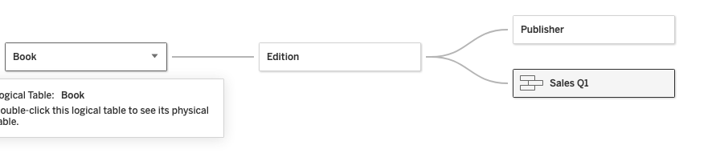
Challenge
Use the bookshop.xlsx
Join the tables. Create a union for Sales Q1, Q2, Q3, Q4
Create a filter for the publisher “CHP”
Create a line chart for book sales over time (continuous weekly). Distinguish the individual book titles by color.
CHP has a benchmark for book sales of 20/week. Create a parameter for this benchmark and add it to the y axis as a reference line
Create an annotation for the best selling book for this publisher
Create an annotation for books that consistently fall below the benchmark

Slide 20
